Slide 1

Software Engineering
Digital Bus Fare System
Submitted by:
Md. Hasibur Rahman - 19101009
Tanmoy Mazumder - 19101013
Shawan Das - 19101020

Slide 2




Contents
2.
Requirement Analysis
1.
Software Proposal
3.
ER Diagram

Slide 3
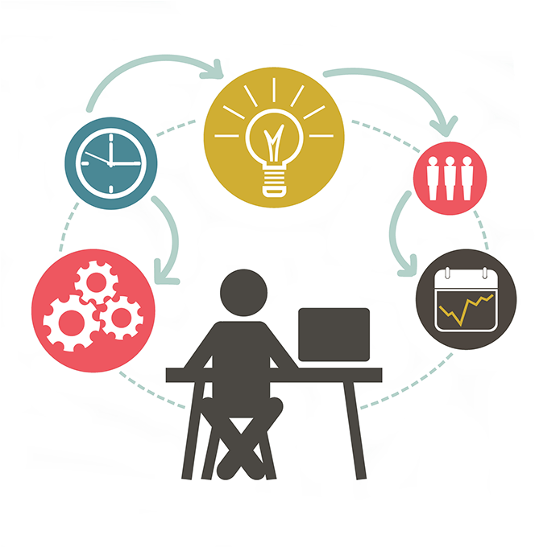
1.Software Proposal

Slide 4




Introduction
Regular Bus fare collection system is riddled with inconveniences.
Digital Payment
Problem Statement
Distance to Fare Ambiguity
Petty Squabbles
Time consuming
No transaction history
Cash-less Convenient Transaction
Proposed Solution
NFC based automated payment system.

Slide 5

The Digital Fare System
Vehicle
Mobile
NFC scanner
Distance Measurement
GPS
Account Management(Reg, Login, Bus location, Report)
NFC interaction
Integrated Payment Gateway(Payment, History)

Slide 6
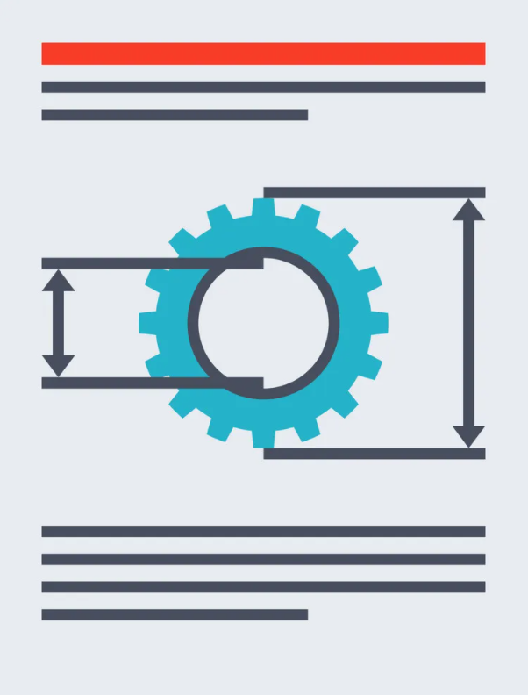
2.Requirement
Analysis

Slide 7
Process:
Feasibility check:
Eliciting requirement:
We need to communicate with customers to gather their requirement.
Analyzing requirement:
Before movie next step we need to clear every issue with unclear and incomplete requirement.
Requirements modeling:
Store requirements as documents.
Review and retrospective:
It gather all the requirement and improve any unclear side the of the phase before moving next phase.
1. Economic:
We will analyze NPV, ROI, BEP for the proposed project. Because doing so we will be able to know if this project is economically feasible for us and investor.
2. Legal:
NFC is a legal process. Other countries use it as their daily needs. So, there is no problem with legal feasibilities.
3. Operation feasibility:
It is operationally feasible as the proposed solution properly deals with the payment problem.
4. Technical:
For proposed proposal our team are capable to executing the task.
5. Schedule:
We need 5 months to build the system as the clients need two fully operational systems for their product.

Slide 8

3.Entity Relation Diagram

Slide 9
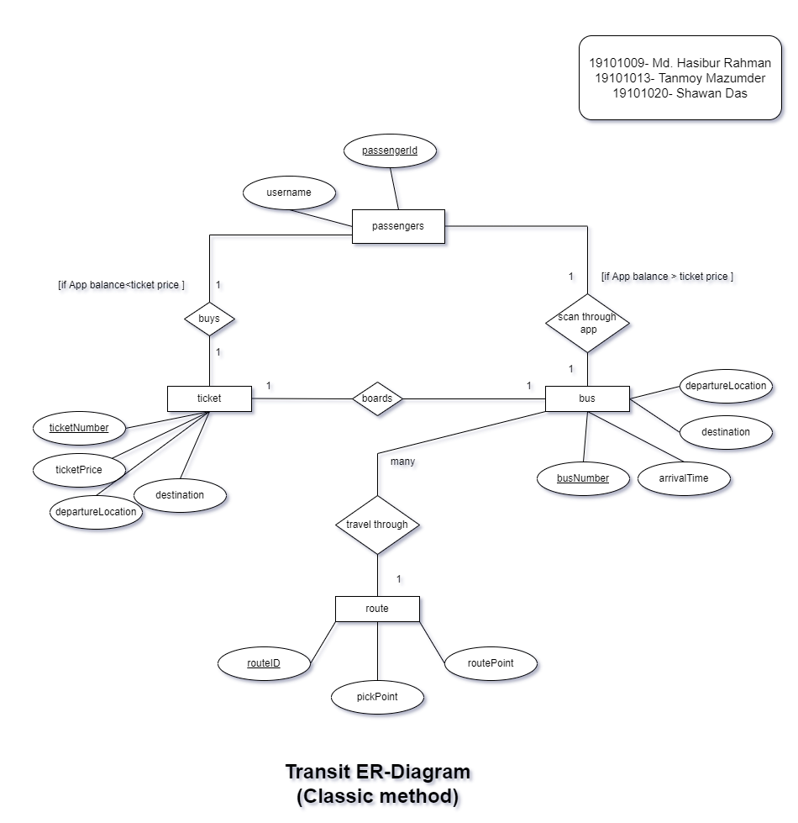
Transit ERD
Diagram between User - Transport

Slide 10
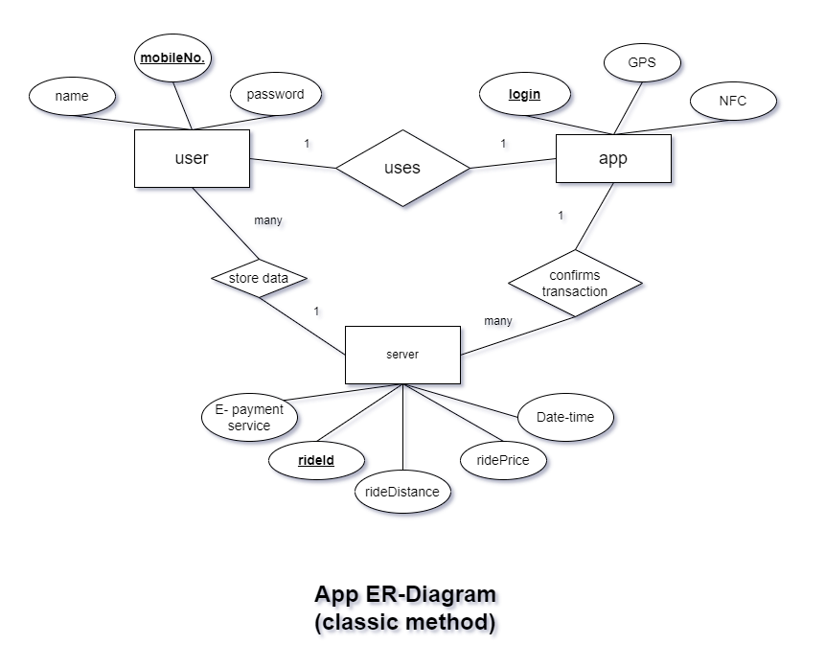
APP ERD
Relation between User app- Server

Slide 11
Thank You

